Slide 1
Docker 101

Slide 2
Welcome to Docker 101
We will start soon…
Pre-requirements:
Sign up for a Docker account at https://hub.docker.com/
Use your Docker login at https://labs.play-with-docker.com/
Labs are at https://github.com/IBM/intro-to-docker-lab

Slide 3
Table of Content
A brief history of containers
What are containers?
VM vs Container
Container vs Docker
Our first container
“ssh-ing” into a container
A look under the covers
Docker Images
Docker Registry
Build your own image with a Dockerfile
Docker special sauce: Layers
VM vs Container: Notice the layers!
Shared/Layered/Union Filesystems
Summary
In a Traditional Deployment
Container = Code + Dependencies
Container Life-Cycle
Lab Time

Slide 4
Introducing Containers and Docker
Containers – not a new idea
(1979) `chroot` command, changes apparent root for running process to isolate system processes
(1982) `chroot` added to Unix v7
(1990s) `jail` command created
(2000) `jail` added to FreeBSD to isolate filesystems, users, networks etc.
(2001) Linux VServer is a jail mechanism that partitions resources (file systems, network addresses, memory)
(2004) Solaris Containers using Solaris Zones, application has a full user, processes, and file system, and access to the system hardware, but can only see within its own zone.
(2005) Open VZ (Virtuzzo), OS-level virtualization for Linux using a patched Linux kernel for virtualization, isolation, resource management and checkpointing
(2006) Google launches `Process Containers` for limiting resource usage, renamed `cgroups`in 2007
(2008) `cgroups` merged into Linux kernel 2.6.24, becoming LinuX Containers (LXC)
(2009) Cloud Foundry developed by VMWare called Project B29 (Warden, Garden)
(2011) Cloud Foundry started Warden
(2013) Docker released as open source
(2014) LXC replaced by `libcontainer`, Google contributes container stack `LMCTFY` (Let Me Contain That For You) to Docker project as `libcontainer` in 2015
Isolation
Isolation
process 1
process 2
OS / kernel
hardware
Notes:
The concept behind Docker containers and the widespread industry interest is not a new idea. The ability to isolate a process from other processes and their use of resources on a common kernel and hardware has been evolving since choot provided a way to implement file space isolation with unix in the '80s.
This evolved to bring more features over time, in early 2000's there were FreeBSD jails, and also user-space virtualization solutions, open source and proprietary products
Solaris Containers and LXC were quite feature-rich, providing just about everything needed for an os-virtualization solution.
Because container systems did not require multiple operating system installations and hypervisors, they have had an edge in efficiency over vms. But VM's which also matured over the same period grabbed major mindshare and use as IT developed consolidation models and grew into Cloud
Docker containers have risen in popularity and use with developers because of the ecosystem approach in combination with platform support for development workstations... Can get Docker engine for MacOSX, Windows, Linux platforms and it runs across server platforms even Linux on IBM 390/system Z

Slide 5
What are Containers?
Similar to VMs but managed at the process level
"VM-like” isolation achieved by set of "namespaces" (isolated view)
PID –isolated view of process IDs
USER- user and group IDs
UTS - hostname and domain name
NS - mount points
NET - Network devices, stacks, ports
IPC - inter-process communications, message queues
cgroups - controls limits and monitoring of resources
The key statement: A container is a process(es) running in isolation
Notes:
VMs isolate at the Operating System level. Multiple independent OS, vs one OS with multiple independent processes.
VM running in isolation - full-blown operating system
Container - run just the processes that you need to get your business function done
- example: tomcat processes -
Container uses namespaces - provides its own view of the world in terms of….
- elaborate on PID namespace as an example. PIDS don’t match host or other containers. Mapped to host.
- namespaces includes all key aspects of a VM
- root file system for each container, means containers get its own view of a file system
CGroups
- limit number of resources so that one container doesn’t take over the machine
Namespaces and protecting
- Access to host? can do anything
- container security is about preventing from hackers from “Escaping the containers”
- users do not have access to the host

Slide 6
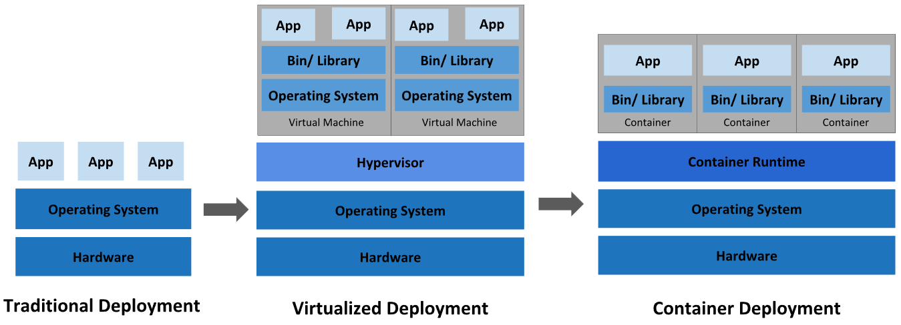
VM vs Container
Before containers, OS environment:
Entanglement between OS and App
Entanglement between runtime environment and OS
Version dependency and conflicts between Apps
Breaking updates
Updates require full app stop and downtime
Deployment and Maintenance of HA system is complex
Slow startup time
image source: https://kubernetes.io/docs/concepts/overview/what-is-kubernetes/

Slide 7
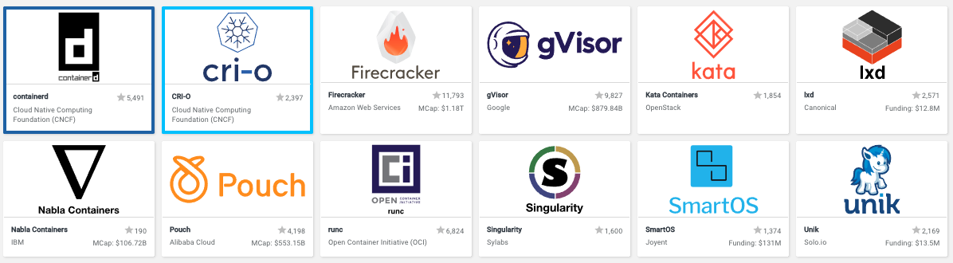
Container Runtime
In December 2014, CoreOS (now RedHat) released “rkt” as an alternative to Docker and initiated app container (appc) and application container image (ACI) as independent committee-steered specifications, which developed into the Open Container Initiative (OCI).
On June 22, 2015 the Open Container Initiative (OCI) was announced, formed under the Linux Foundation and launched by Docker, CoreOS and others. The OCI currently contains a Runtime Specification (runtime-spec) and an Image Specification (image-spec).

Slide 8
Containers vs Docker
Containers is the technology, Docker is the tooling around containers
Without Docker, containers would be hard to use (for most people)
Docker simplified container technology
Added value: Lifecycle support, setup file system, etc
For extra confusion: Docker Inc. is a company, which is different than Docker the technology…
Docker’s ecosystem approach transformed the perception of containers,
Building application-centric containers
Mechanism for sharing images (Docker Registry)
Open-source enabled

Slide 9
Our First Container
$ docker run ubuntu echo Hello World
Hello World
What happened?
Docker created a directory with a "ubuntu" filesystem (image)
Docker created a new set of namespaces
Ran a new process: echo Hello World
Using those namespaces to isolate it from other processes
Using that new directory as the "root" of the filesystem (chroot)
That's it!
Notice as a user I never installed "ubuntu"
Run it again - notice how quickly it ran
Notes:
Fast to run containers, but a little bit of work ahead of time
once and image is downloaded, it will be very fast to run subsequent containers

Slide 10
"ssh-ing" into a container
$ docker run -ti ubuntu bash
root@62deec4411da:/# pwd
/
root@62deec4411da:/# exit
$
Now the process is "bash" instead of "echo"
But its still just a process
Look around, mess around, its totally isolated
rm /etc/passwd – no worries!
MAKE SURE YOU'RE IN A CONTAINER!
Notes:
how to debug a container…
but don’t start an ssh daemon (security hole)
-it tty and stdin stdout to connect to terminal
-i by default doesn’t connect stdin
-t psudeo-tty - connect terminal emulator - need this to have things like bash to work
here we assume that the “bash” program is included inside the container image we are attempting to run
containers are given a set of privileges - cannot run sys calls to shutdown machine
can delegate what sys calls each container has access to
comes with default profile that limited

Slide 11
A look under the covers
$ docker run ubuntu ps -ef
UID PID PPID C STIME TTY TIME CMD
root 1 0 0 14:33 ? 00:00:00 ps -ef
Things to notice with these examples:
Each container only sees its own process(es)
Each container only sees its own filesystem
Running as "root"
Running as PID 1
Notes:
can only see process IDs on the host
running as root by default
process is running as PID 1

Slide 12
Docker Images
Tar file containing a container's filesystem + metadata
For sharing and redistribution
Global/public registry for sharing: DockerHub
Docker Host
Containers
Containers
Images
Ubuntu
Liberty
Docker Engine
Base OS/Kernel

Slide 13
Docker Registry
DockerHub (https://hub.docker.com)
Public registry of Docker Images
The central place for sharing images with friends or coworkers!
Also useful to find prebuilt images for web servers, databases, etc
Enterprises will want to find a private registry to use (such as Artifactory)
Docker Host
Containers
Registry
Containers
Ubuntu
Liberty
Images
nginx
mysql
Ubuntu
Liberty
Docker Engine
Base OS/Kernel

Slide 14
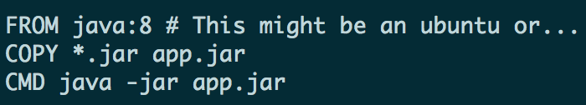
Build your own image with a Dockerfile!
Step 1) Create Dockerfile to script how you want the image to be built
Step 2) docker build to build an image
Step 3) docker push to push to registry
Step 4) From another location, docker pull to download an image
Notes:
Docker. Not a new technology
Containers have been around for a while (IBM helped invent it)
Docker created a tool for the masses
- tool on top of containers
- containers does not mean docker (other providers out there)
- docker implemented tooling very well

Slide 15
Docker special sauce: Layers
Let's compare VMs and Containers one more time...

Slide 16
VM vs Container: Notice the layers!
Virtual Machine
Container
Virtual Machine
Container
Virtual Machine
Container
App
App
App
<- Layer
bins / libs
bins / libs
<- Layer
VS
Operating System+procs
VS
OS-specific files
<- Layer
Hypervisor
Base OS/Kernel
VM?
Hardware
Hardware
Each VM has its own OS
Containers share the same base Kernel

Slide 17
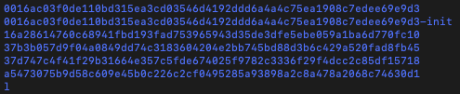
Shared/Layered/Union Filesystems
Docker re-uses common layers between containers and images
A single writeable layer is added on the top every time a new layer is created
Layers are “smushed” with union file system (think transparencies on a projector)
Files are copied up when writes need to be made (copy-on-write)
Bottom Line
More containers per host
Faster downloads and uploads
Faster container startups
ls /var/lib/docker/overlay2
CNTR1
CNTR2
CNTR3
CNTR4
Layer
app1
app2
app3
app4
Layer
tomcat
liberty
tomcat
Layer
Fedora
Ubuntu
Base OS / Kernel
Filesystem

Slide 18
Summary
Why? When compared to VMs:
Low hardware footprint, better resource utilization (CPU, Memory, Disk – resources managed using namespaces and cgroups),
Faster start-up times, no OS install or restart
Quick deployment
Better efficiency, elasticity, and reusability of the hosted applications
Better portability of platform and containers
Environment isolation, changes to host OS do not affect the container
Multiple environment deployment
Reusability
Easier tooling/scripting
Docker value-add:
User Experience
Image layers
Easily share images - DockerHub

Slide 19
Summary
Docker is a tool to manage containers
Key concepts: Containers, Engine, Images, Registry
Docker value-add:
An excellent User Experience
Image Layers
Easily shared images - DockerHub
Why? When compared to VMs:
Better resource utilization - CPU, Memory, Disk
Faster start-up times
Easier tooling/scripting
Discussion / Questions?

Slide 20
In a Traditional Deployment…
Are you testing these on ever commit?
Code (packages archive)
App server
Runtime versions
System libraries and versions
Notes:
Windows Containers available in Windows Server 2016 Tech Previews, and on Windows 10 Insider Track
“multi-architecture image” docker hub will pull the correct version
people have to go out of their way to build these images
pull x86 image, will it run on Power or Z? probably not
which images are for Power or Z? can’t tell on docker hub
create namespace to identify different architecture support

Slide 21
Container = Code + Dependencies
Code (packages archive)
App server
Runtime versions
System libraries and versions

Slide 22
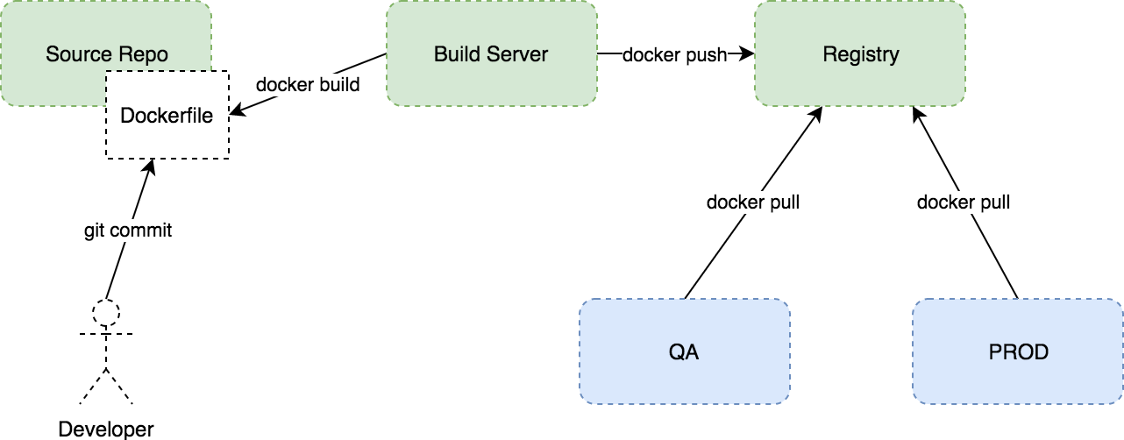
Container Life-Cycle
Notes:
this seems like a restriction, but if you think about the benefits of stateless applications its actually going to fit in perfectly with our best practices (12 factor)
stateless applications allow you to
scale.
any application instance can serve any request
graceful shutdown and quick startup times because of shared layers

Slide 23
Lab Time

